Slide 1
POPCORN
YOUR OWN MOVIE LIBRARY
CSC-490 Senior Capstone
Instructor: Jeff Whitworth
University of North Carolina Greensboro

Slide 2

Team members
Alana Traylor
project management, lead the direction of the design and layout. Website building, API connection, assisting with database and API connectivity

Slide 3
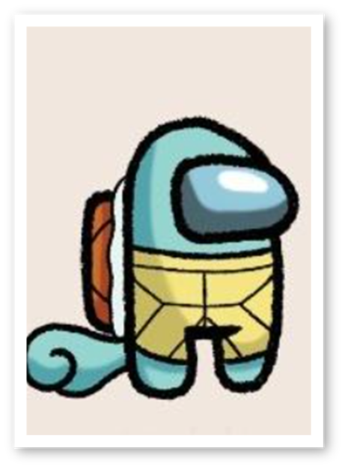
Team members
Sytiva Wheeler:
creation of the database, database connections, various API connections, test and debug any functions that utilize API or Database connections.

Slide 4
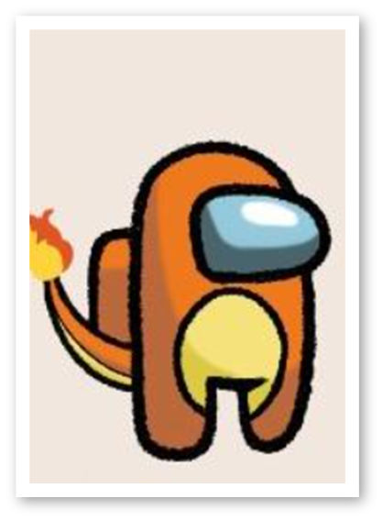
Team members
Pengxu(Aaron)
Project algorithm engineer, designing and implementing movie recommendation algorithms.

Slide 5

Team members
Sonny Proctor
Website user interface layout and design, presentation preparations.

Slide 6
Introduction
Popcorn is a web application that allows users to browse through various genres of movies extracted from the multiple API database.
The website is designed to be user-friendly with a very simple start of creating an account, picking a few genre preferences and which streaming services are going to be used. These inputs are then used to generate which movies are recommended to the user and they are listed in order of highest rating.

Slide 7
Introduction
The user will interact with the interface in terms of having links to where the movie is streamed or the link to the movie on their preferred streaming service. They will be able indicate whether they have watched the movie or want to add to a watch list for future reference. They will also be able to give their own, independent rating as to help the program recommend movies like the one they rated or to stray away from movies related.

Slide 8
WHY (it is needed)
The idea of Popcorn came from the increase of streaming platforms being used by movie watchers at home due to the pandemic. Lots of streaming bundles became popular such as the Disney+ bundle for example. Popcorn will allow users to find the movie they want to watch and which platform it is located on instead of switching between the different apps to browse all over again in the movie section.

Slide 9
WHAT (is the goal)
The goal is to have a web application with all movies listed and users able to get proper recommendations from previous movies they have watched, favorited or based on their specific preferences along with which movie streaming service they use.

Slide 10
HOW (this was achieved)
Approach and languages
Functional approach with PHP, HTML,CSS, Bootstrap, MDBootstrap, AJAX, jquery and a relational database. Hosting done with Microsoft Azure and file transfer is done using Filezilla.
Testing
Visual Studio Code (VSCode) IDE is used to create web pages. XAMPP Control Panel used to test web pages before transferring them to the server using FileZilla. Dummy records have been inserted to test if functions that call to database are working correctly.

Slide 11
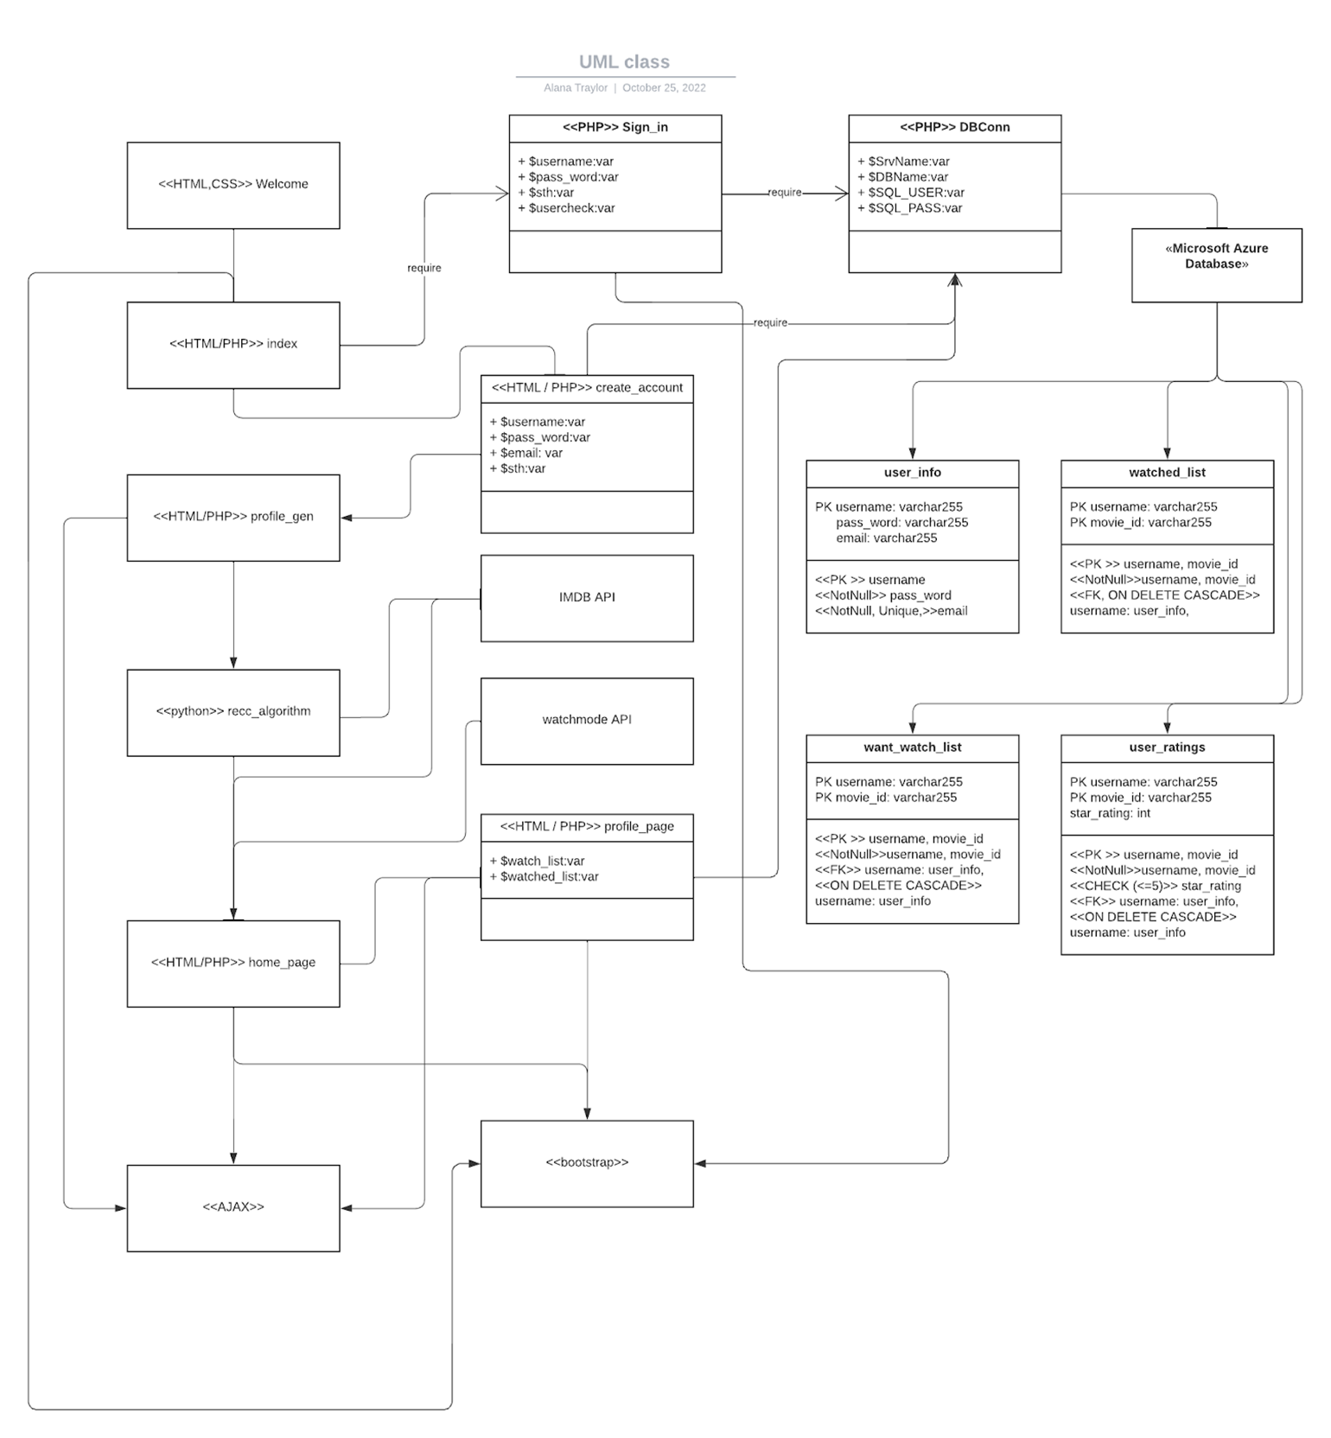
SUBSYSTEMS:
UML Diagram

Slide 12
SUBSYSTEMS:
User manual
The user would create an account or be offered to sign in, if they click sign in and do not in fact have an account there is a create account button that will send them to the create account page. There is also a forgot password button in case the user forgets and needs to reset in order to log in. If the user takes the create account route after creating username and password, they will need to pick at least 3 different genres of movies in order for recommendations to appear.
After genres have been chosen or if the user took the sign in route, they will be directed to the homepage which will have the poster, title and genre of the movies displayed for their choosing. In the corner there will be 3 horizontal lines that when clicked will take you to a navigation bar where you can choose to view your profile, watched list, and want to watch list.

Slide 13
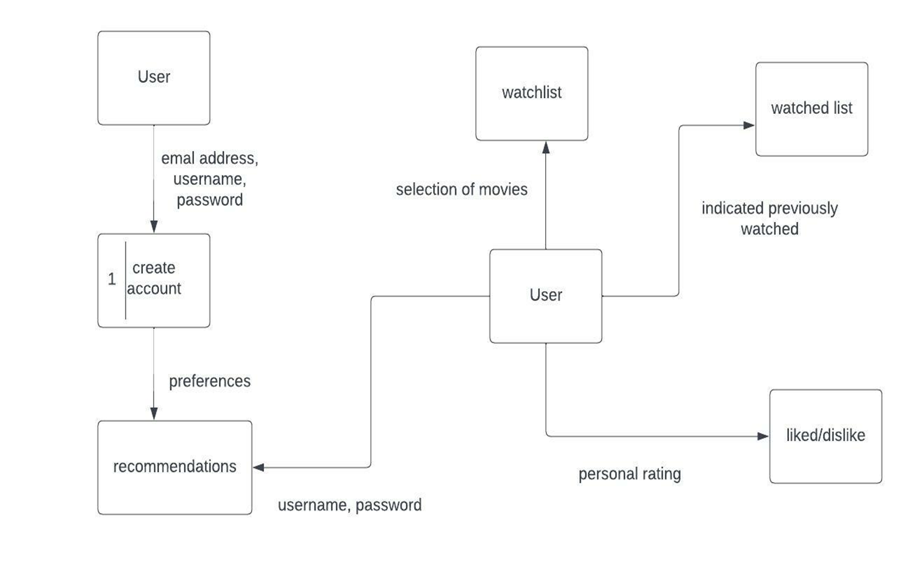
SUBSYSTEMS:
User manual
In the user profile, there is name, age, username, password, option to change password and preferences. The name and age along with a profile picture can be added or edited only after the account already exists. The username can also be edited. In the watched listed there will be a list of movies that the user has already watched, this list is curated from the user's indication on the movie whether they have watched or want to watch the film by buttons located alongside each movie poster. If indicated, they want to watch the film then it will be moved to the want to watch list.

Slide 14
SUBSYSTEMS:
User Interface Design
With yellow-orange as the main tone, the design is done in css and php, the fonts and buttons can be distinguished at a glance, and the overall design is as close to commercial standards as possible.

Slide 15
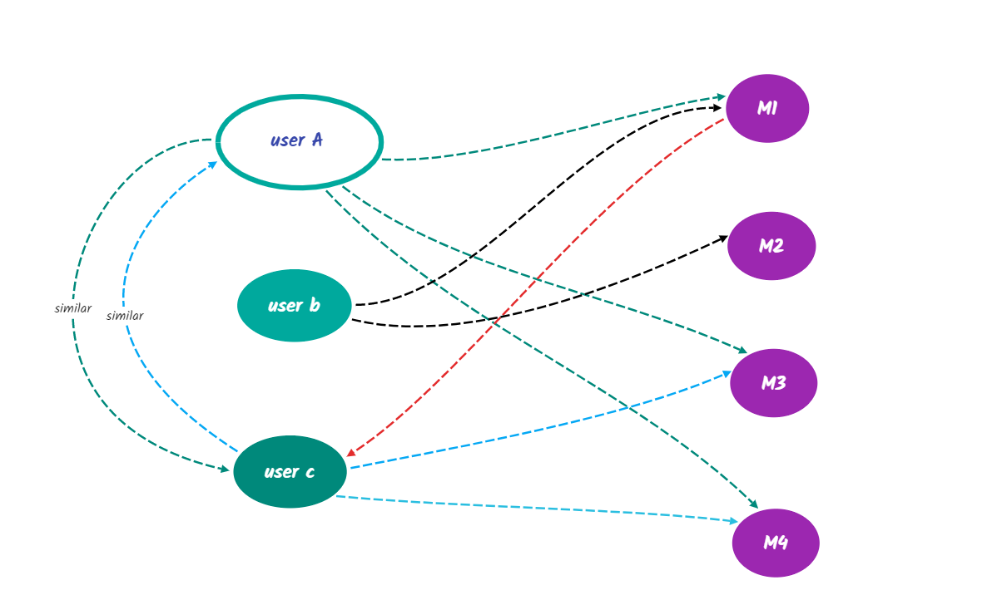
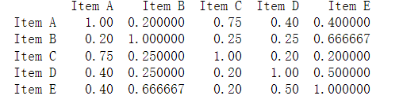
Popularity-Based Recommendations:
Recommendation based on collaborative filtering: find users with similar histories and see what movies to watch again
user-based CF
item-based CF

Slide 16
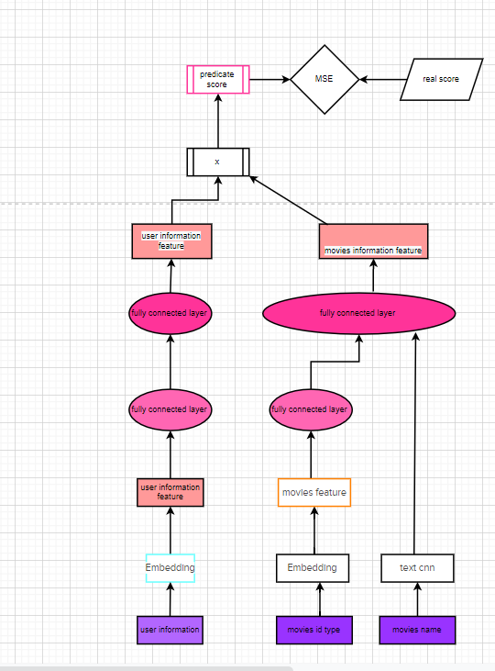
convolutional neural network- CNN
train model-test model-Adjusting model parameters-Predictions for new users
1.Recommended films in the same genre
2.recommending movies that users like
3. What other movies have people who have seen this movie watched (or liked)

Slide 17
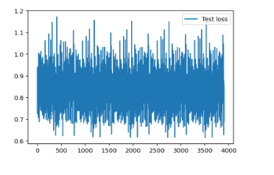
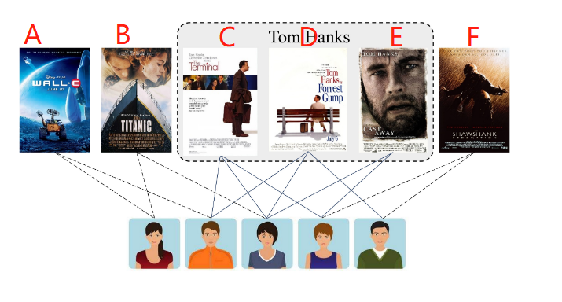
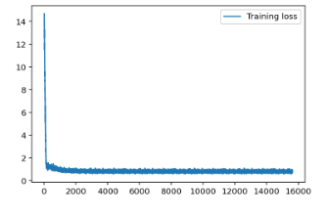
CNN model performance

